Slide 1

SNUC
HACKS
PITCH DECK
Team Name:
404_TEAM NOT FOUND
Problem Statement:
1
SREE ADITYA
sreeaditya24110041@snuchennai.edu.in
Team Leader:

Slide 2
SNUC
HACKS
PROBLEM STATEMENT
Job Seekers:
Struggle to create resumes that stand out in Applicant Tracking Systems (ATS).
Lack tools to identify skill gaps and improve their profiles.
Need effective interview preparation resources.
Recruiters:
Spend excessive time sifting through resumes.
Face challenges in matching resumes to job descriptions accurately.
Current Solutions:
Fragmented tools (e.g., Jobscan for ATS, Interviewing.io for mock interview).
Lack of a unified platform that addresses all aspects of the job search process.

Slide 3
SNUC
HACKS
PROPOSED SOLUTION
Innovative Career Growth Solution – Enhances career development with AI-driven technology.
Resume Optimization – Improves resumes to increase job seeker success.
Smart Job Matching – Connects candidates with the right opportunities.
Streamlined Job Search – Provides a seamless, data-driven experience.
Stakeholder Value – Delivers intelligent career insights and boosts hiring efficiency.
Interview Preparation – Helps users get ready for interviews with AI insights and with structured resources
All this at one place in a website where both the recruiter and the recruit can connect, assess opportunities, and streamline the hiring process efficiently.

Slide 4
SNUC
HACKS
INNOVATION AND UNIQUENESS
AI-Driven Resume Enhancement:
Uses advanced LLM (Gemini 1.5 flash) to optimize resumes for ATS and readability.
Provides real-time suggestions for improving content and keywords.
Skill Gap Analysis:
Identifies missing skills and recommends courses or certifications.
Helps job seekers align their profiles with industry requirements.
Interview Simulation:
Offers mock interviews with AI-generated feedback on clarity, relevance, and confidence.
Tailors questions to specific job roles and industries.
Portfolio Automation:
Generates professional portfolios from resume data.
Allows customization of themes, layouts, and content.
Benchmarking:
Outperforms existing tools like Jobscan and Huntr by offering a unified platform.
Combines resume optimization, skill matching, interview prep, and portfolio building in one solution.

Slide 5
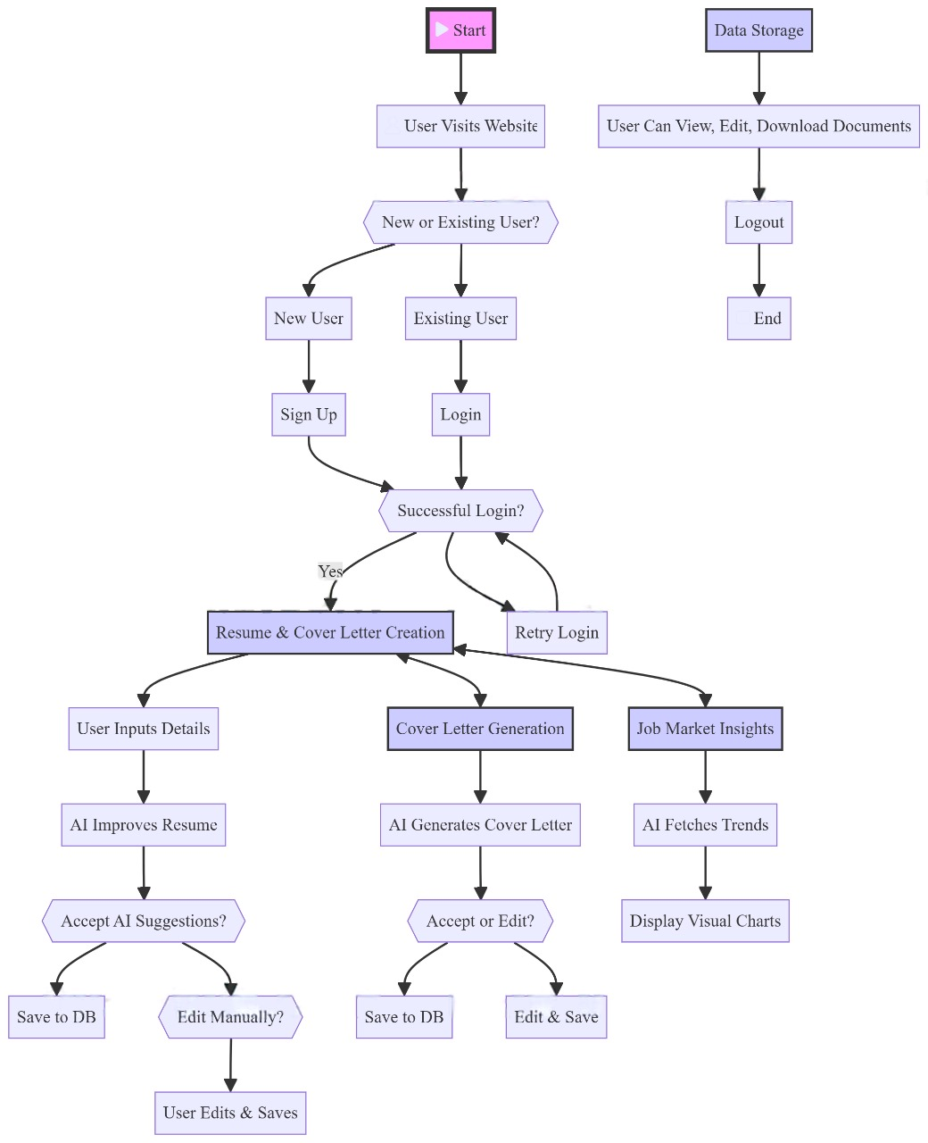
SNUC
HACKS
TECHNICAL ARCHITECTURE flowchart

Slide 6
SNUC
HACKS
TECHNICAL ARCHITECTURE
FRONTEND
BACKEND
Using Next.js, Clerk Auth
Interactive UI for resume building & insights
Secure authentication with Clerk
Backend (Node.js, Prisma)
Handles resume & cover letter generation with AI
Manages database operations using Prisma ORM
HOSTING/FUTURE IMPROVEMENTS
DATABASE
Hosted with Vercel
Future improvements or correcting bugs
Built with Prisma(Postgrasql)
Stores resume details, parsed skills, and job recommendations.
Stores user details, authentication tokens, and session management.

Slide 7

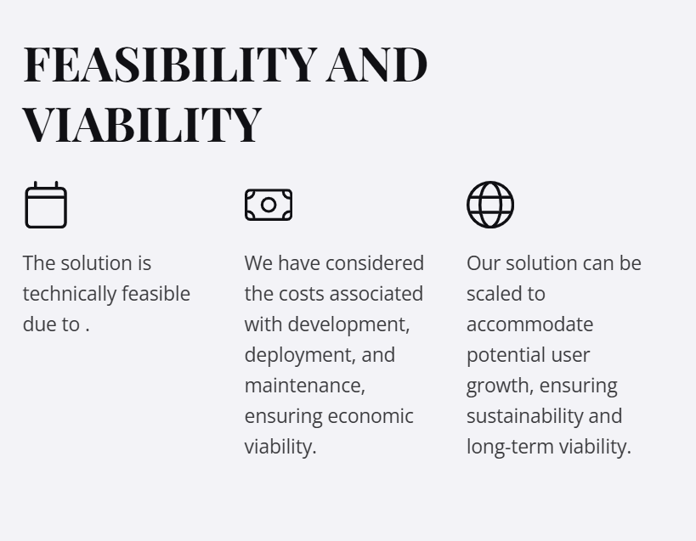
SNUC
HACKS
FEASIBILITY AND VIABILITY

Slide 8
SNUC
HACKS
DEMO, IMPACT AND BENEFITS
Impact :
Empowers job seekers with AI-generated resumes & cover letters.
Provides market insights to align skills with industry trends.
Saves time by automating resume building & research.
Benefits :
AI-powered resume & cover letter optimization using Google Gemini.
Real-time job market insights with salary trends & skill demand.
Secure & seamless login with Clerk authentication.
Fast & scalable performance with Next.js, Node.js, and Vercel.
User-friendly interface with customizable templates.
Transforms job hunting with AI-driven career intelligence!

Slide 9
SNUC
HACKS
RESEARCH AND REFERENCES
🔗 AI & Resume Optimization:
Google Gemini AI - https://ai.google.dev/
Resume.io - https://resume.io/
🔗 Job Market Trends & Career Insights:
LinkedIn Jobs - https://www.linkedin.com/jobs/
Career Overflow - https://www.careeroverflow.io/
Naukri - https://www.naukri.com/
🔗 Components used :
For frontend UI – Modern UI https://ui.shadcn.com/

